Slide 1
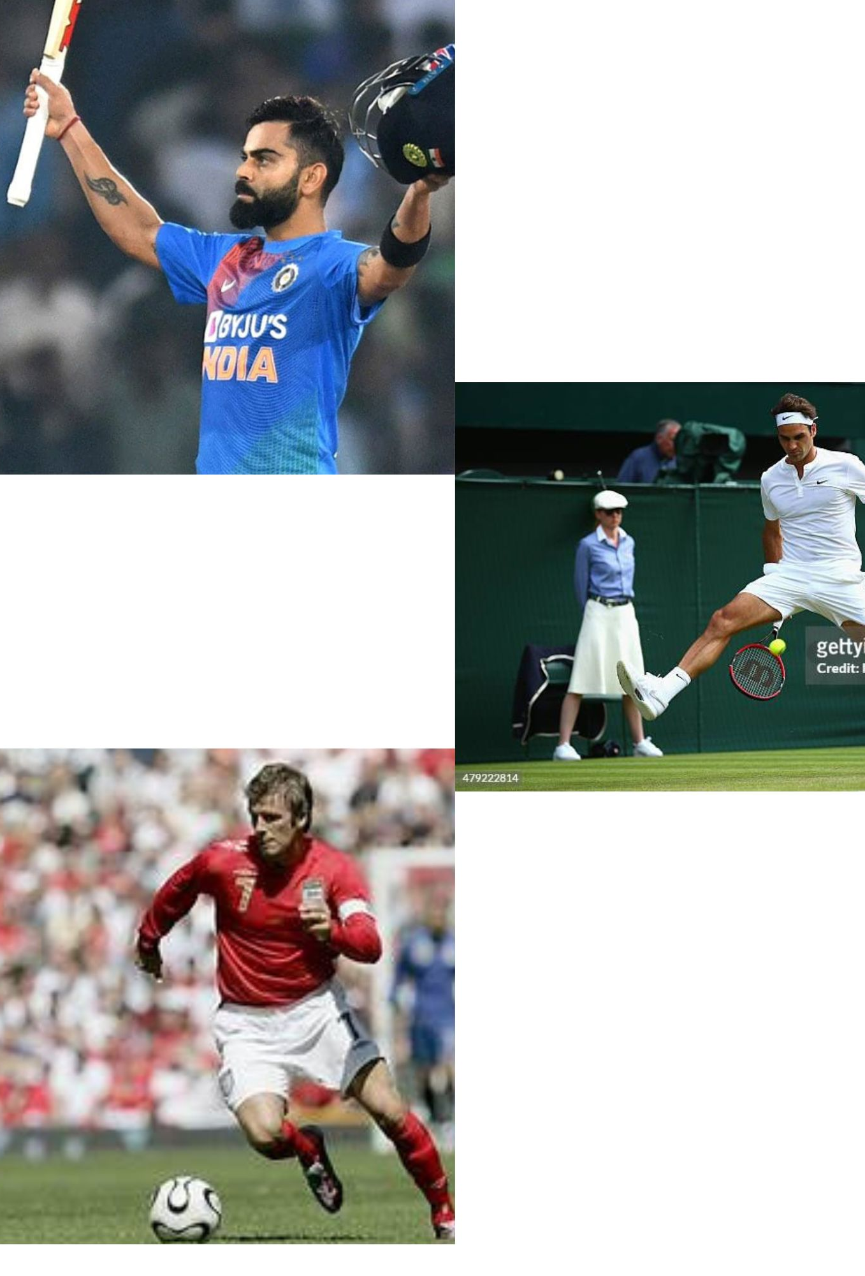
INSY 5378- 002 Sports Image Classification
Instructor
Dr. Sridhar Panchapakesan Nerur
Submitted by
Charan Tej Reddy Koppala
Venkata Laxmana Srikanth Bharam

Slide 2
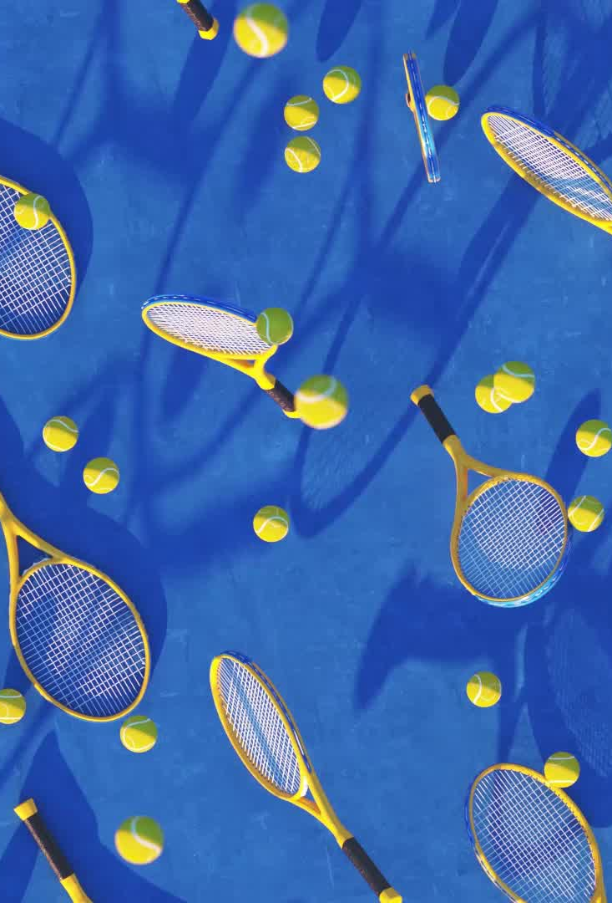
Introduction
Sports are a global phenomena that offer a vast array of events, behaviors, and moments that are perfect for machine learning classification. The Sports Image Classification project's primary objective is to build an intelligent model that can identify various sports and sports-related activities inside of images. The goal of this project is to give sports fans, commentators, and analysts a versatile tool that can differentiate between different sports, such as basketball and soccer, based on different distinguishing characteristics, such the recognized sports equipment.

Slide 3

Objective
Developing a machine learning model to classify sports images accurately

Slide 4

Data set details
Source of the data set is taken from Kaggle.
The source link is https://www.kaggle.com/datasets/sidharkal/sports-image-classification/data
A dataset with images of several sports classes is given to the machine learning model.
There are two sets of the dataset: a test set and a training set. The training set consists of up of labeled photos from the following sports classes: karate, swimming, tennis, badminton, cricket, wrestling, and soccer.
Every image has a distinct image ID and corresponding class label assigned to it.
You must determine the class of the unlabeled photographs in the test set.

Slide 5
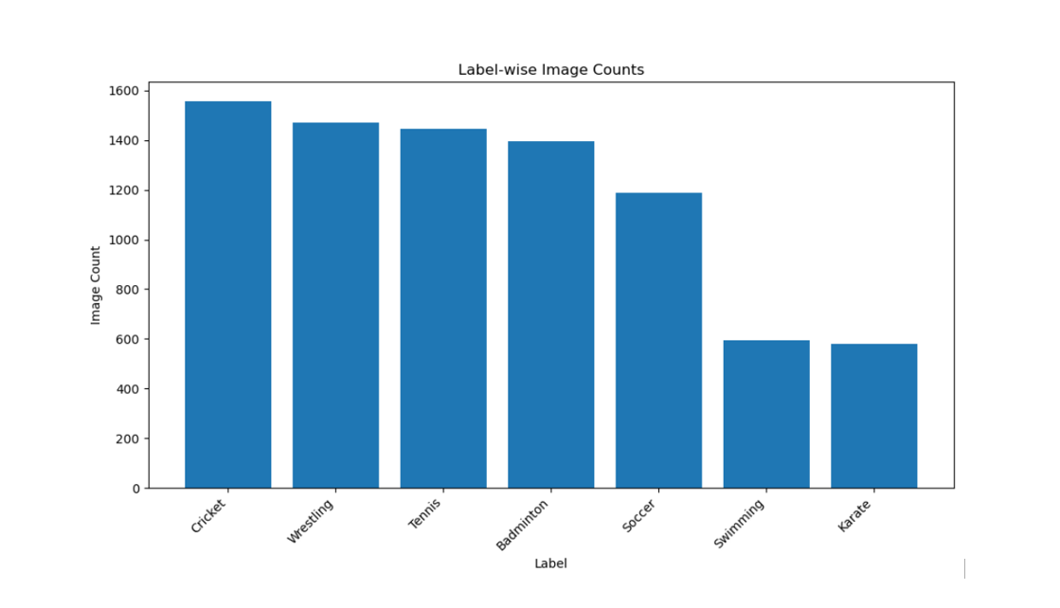
Data Exploration
The histograms shows that number of images that are present for each sport.
The dataset contains image name and label of the sport as the attributes.

Slide 6
Building the Machine Learning Model
The machine learning model for the image classification is built based generally using convolution neural networks(CNN).
What is CNN?
It is deep learning technique widely used for the image classification, facial recognition and image analysis.
There are other models we used here in the project which are VGG16, ResNet and Inception.

Slide 7
Layers in CNN
Convolutional Layers: The core building block of a CNN. It involves the application of convolution operations to the input data. Convolution helps the network learn hierarchical representations by capturing local patterns in the input.
Pooling Layers: Pooling layers (e.g., max pooling) are often used to reduce the spatial dimensions of the input volume. Pooling helps in retaining important information while reducing the computational complexity and the number of parameters in the network.
Activation Functions: Activation functions (e.g., ReLU - Rectified Linear Unit) are applied to the output of convolutional and fully connected layers to introduce non-linearity into the network, allowing it to learn complex relationships in the data.
Fully Connected Layers: After several convolutional and pooling layers, the high-level reasoning in the neural network is captured by fully connected layers. These layers connect every neuron to every neuron in the previous and subsequent layers.

Slide 8
Flattening: Before feeding the output of convolutional and pooling layers into fully connected layers, the data is often flattened to convert it into a one-dimensional array.
Dropout: Dropout is a regularization technique commonly used in CNNs to prevent overfitting. It randomly drops a fraction of neurons during training, forcing the network to learn more robust features.
Loss Function and Optimization: For classification tasks, a softmax activation function is often used in the output layer, and the categorical cross-entropy loss function is commonly employed. The optimization process is carried out using algorithms like stochastic gradient descent (SGD) or its variants.
Data Augmentation: To increase the diversity of the training dataset and improve generalization, data augmentation techniques (e.g., rotation, flipping, zooming) are often applied to the input images during training

Slide 9
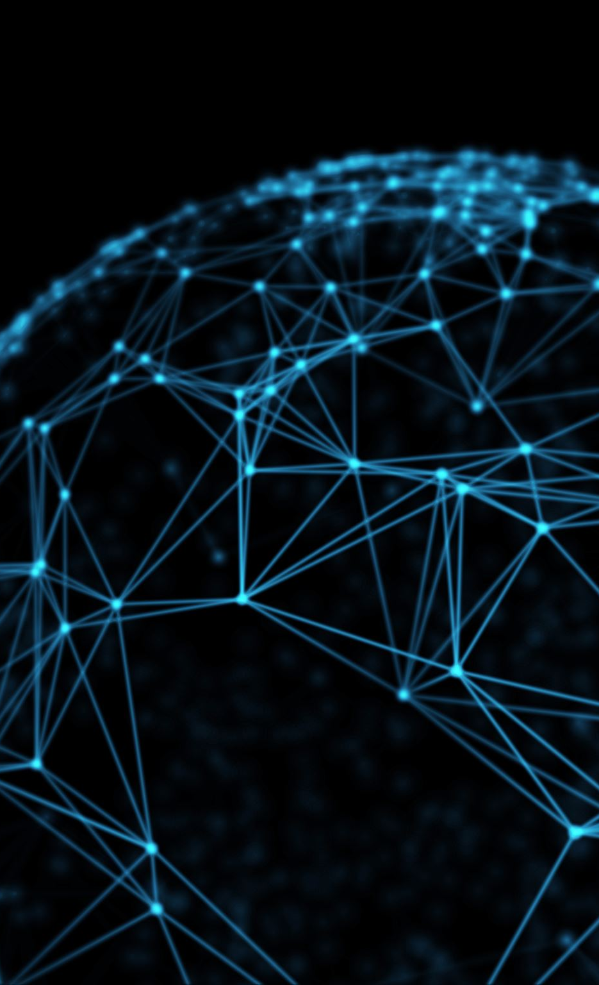
VGG16
VGG is Visual Graphics Group. It is a CNN architecture. VGG16 means 16 layers.
VGG16 consists of 16 weight layers, including 13 convolutional layers and 3 fully connected layers. The convolutional layers use small 3x3 filters with a stride of 1 and zero-padding, which helps maintain the spatial resolution of the input
VGG16 uses only 3x3 convolutional filters and 2x2 max-pooling layers. This simple and uniform architecture with small filters is a distinctive feature of VGG16.
It uses ReLu as activation function.

Slide 10
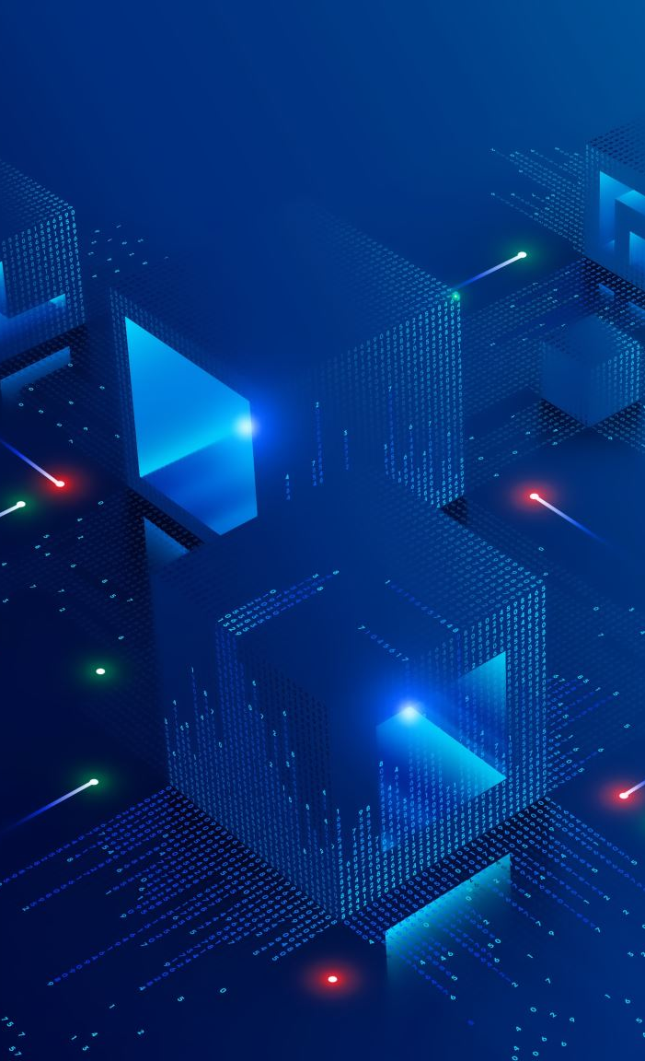
ResNet
Short form for Residual Network. Fundamental building blocks are called Residual block. It is a deep neural network architecture.
A residual block is composed of two paths: a "shortcut" path and a "main" path. The shortcut path directly passes the input to the next layer, while the main path performs the standard convolutional operations. The output of the main path is added to the input of the block, allowing the gradient to flow easily through the network.
ResNet architectures can be very deep, with hundreds or even thousands of layers. The addition of shortcut connections facilitates the training of deep networks by mitigating the vanishing gradient problem. Deeper networks often lead to better representations of complex features.
It uses Global Average Pooling (GAP)

Slide 11
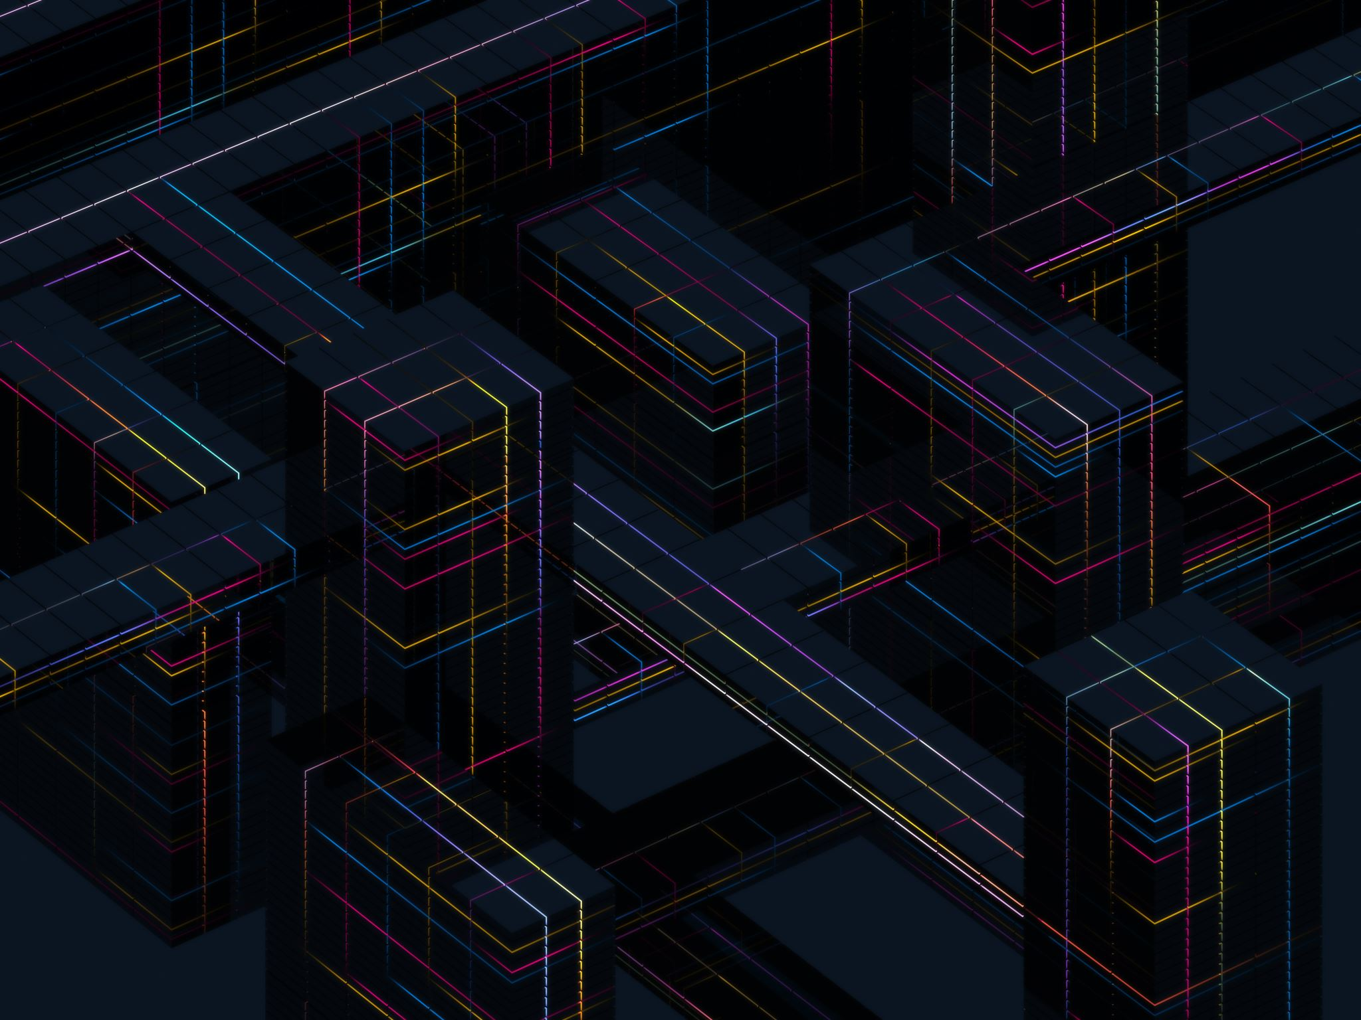
Inception V3
It is another CNN architecture. V3 is variant of this model.
It uses different filter sizes for convolution layers within the same layer.
This allows the network to capture both fine-grained and global features, improving its ability to recognize complex patterns in the input data
Each of these operations is performed in parallel, and their outputs are concatenated along the depth dimension. The goal is to create a diverse set of features that can capture patterns at different levels of abstraction.
| 1x1 Convolution |
| 3x3 Convolution |
| 5x5 Convolution |
| Max Pooling |

Slide 12
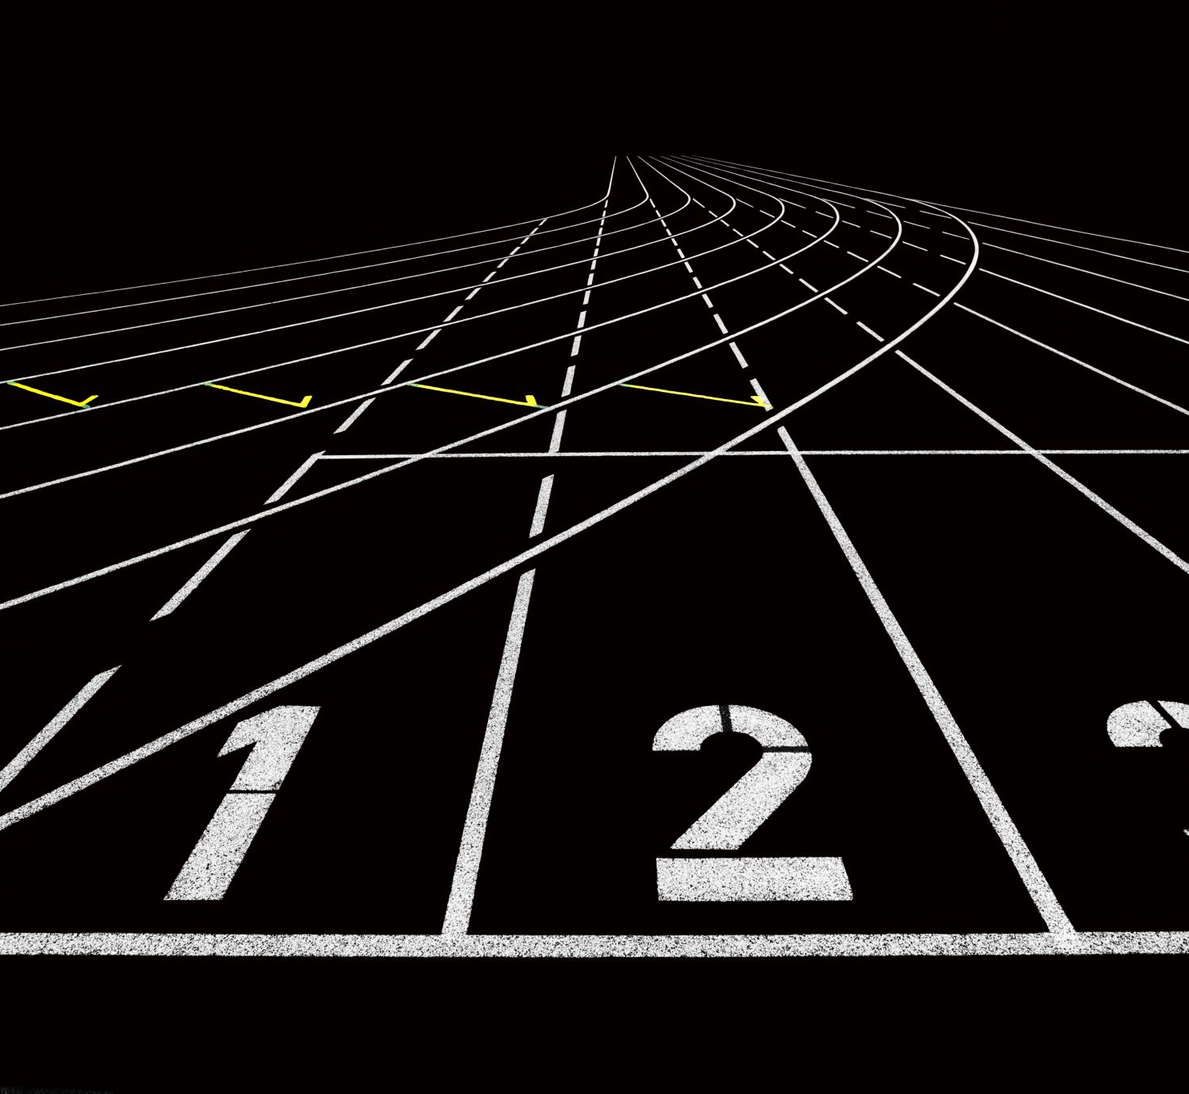
Performance Metrics
After the prediction of the class of the sport, we use various performance metrics for comparison.
1. Classification Report
2. Confusion Matrix

Slide 13
Comparison of all the models
 | CNN | VGG16 | ResNet | Inception
Accuracy | 67% | 69% | 37% | 91%

Slide 14

Thank You

